Slide 2
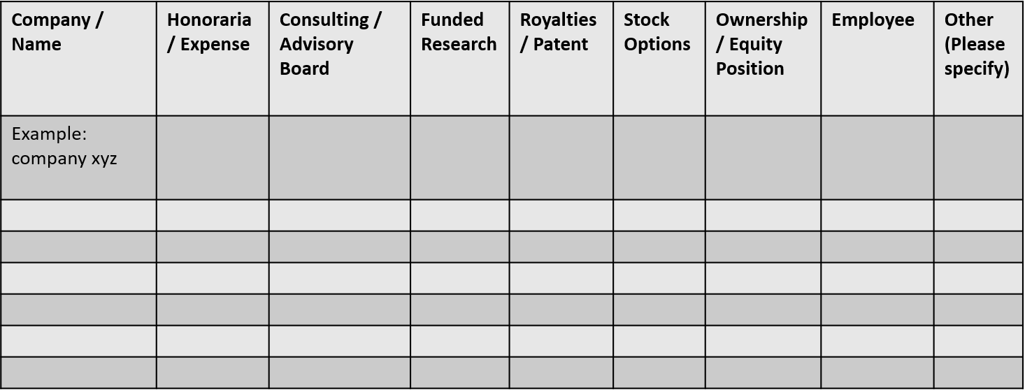
 | No, Nothing to disclose
 | Yes, please specify

